Slide 1
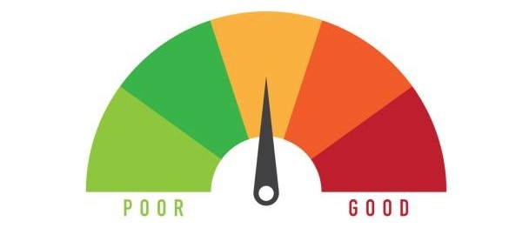
PREDICTIVE ANALYSIS OF
CREDIT RATING

Slide 2
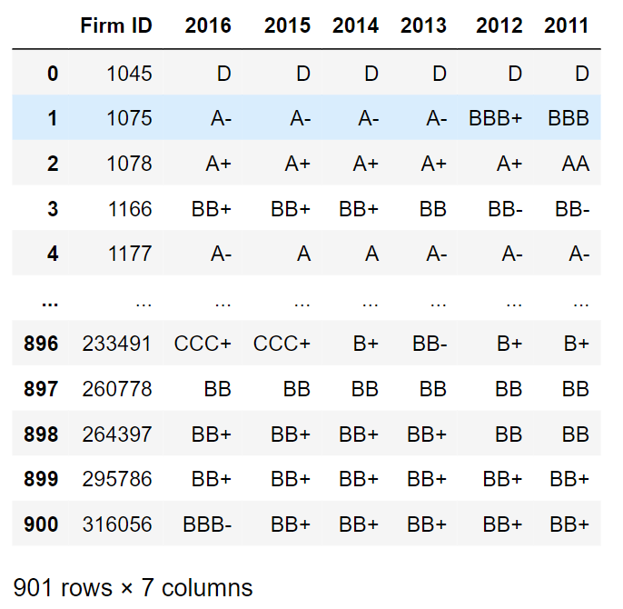
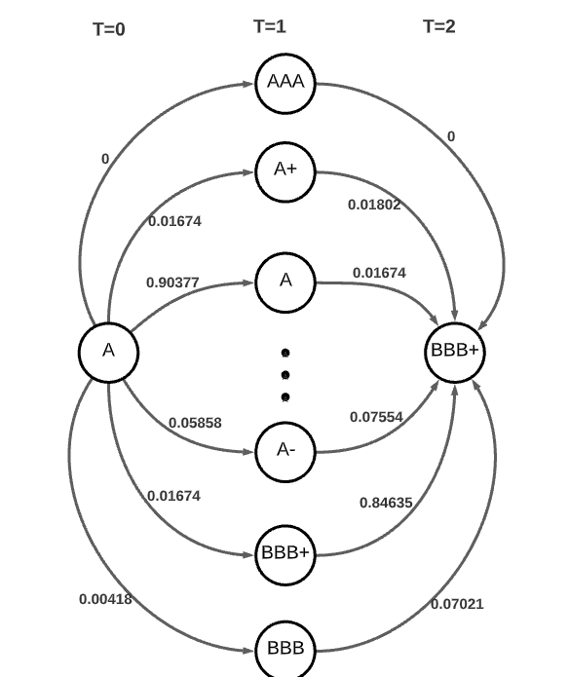
Aim Of The Project : Predicting Corporate Credit Rating Using Markov Analysis
UseFul Data

Slide 3

What is Credit Rating ?
Credit rating is an analysis of the credit risks associated with a financial instrument or a financial entity.
A credit rating can be assigned to any entity that seeks to borrow money—an individual, a corporation, a state or provincial authority, or a sovereign government.

Slide 4


Who issues Credit Ratings ?
Some of the Credit Rating Agencies in India
Credit Rating Information Services of India Limited (CRISIL)
Investment Information and Credit Rating Agency of India Limited (ICRA)
Credit Analysis & Research (CARE)
Onida Individual Credit Rating Agency of India (ONICRA)

Slide 5



Who issues Credit Ratings ?
Some of the Credit Rating Agencies Worldwide (THE BIG THREE)
S&P Global Ratings (S&P)
Moody's Investors Service
Fitch Ratings Inc.

Slide 6
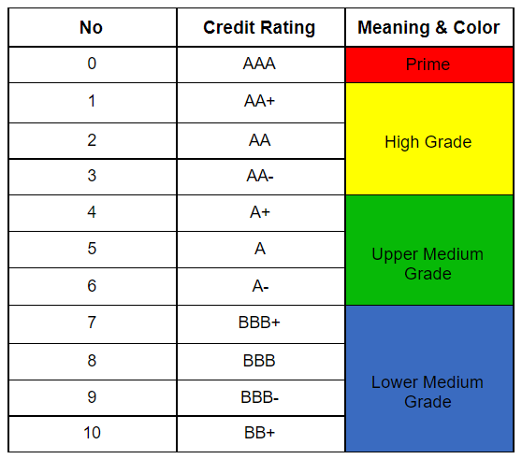
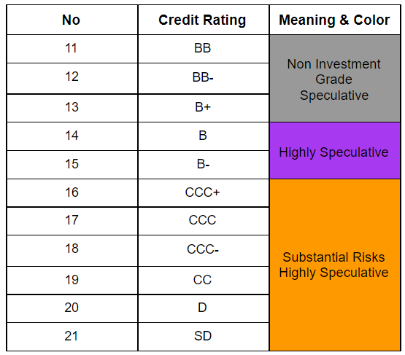
S&P Credit Rating Scales (States)

Slide 7

Importance of Credit Ratings
Credit ratings provide a metric to assess the riskiness of an investment. A credit rating of AAA is extremely secure, however, it will provide significantly less returns than a BBB instrument.
A significant portion of a firm’s decisions in capital markets are influenced by credit ratings, thus, predicting credit ratings becomes an extremely important task to maximise profits and for the purpose of risk management.

Slide 8
Paper review:- Rating migration matrices: Empirical evidence in Indonesia
This paper aims to estimate a credit rating transition matrix and use it to analyse the credit rating migration during a certain period of time.
A transition matrix was constructed for both discrete and continuous timescales. Based on this transition matrix, inferences regarding rating stability, rating quality and default probability were made.
According to the observations -
Rating activity was concentrated around the diagonal.
Higher ratings tend to have a greater stability.
In contrast to the distribution achieved for investment grade companies, the distribution of the speculative rating category was unstable in nature.

Slide 9
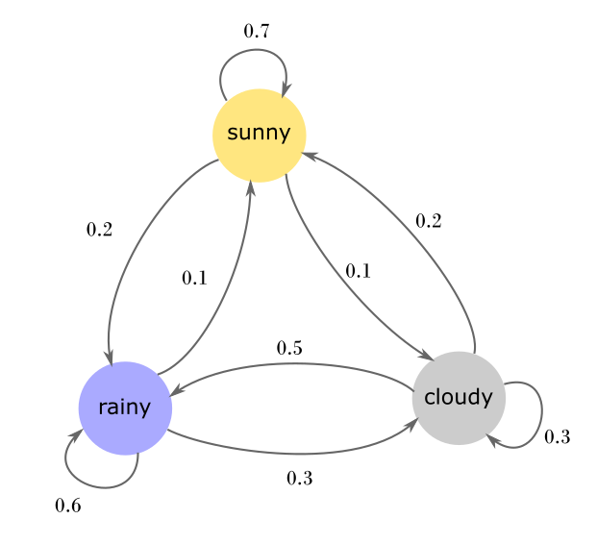
What is Markov Analysis ?
Markov analysis is a method for forecasting the value of a variable whose anticipated value is only impacted by its present state.
The key benefits of Markov analysis are its simplicity and accuracy in out-of-sample predictions.

Slide 10
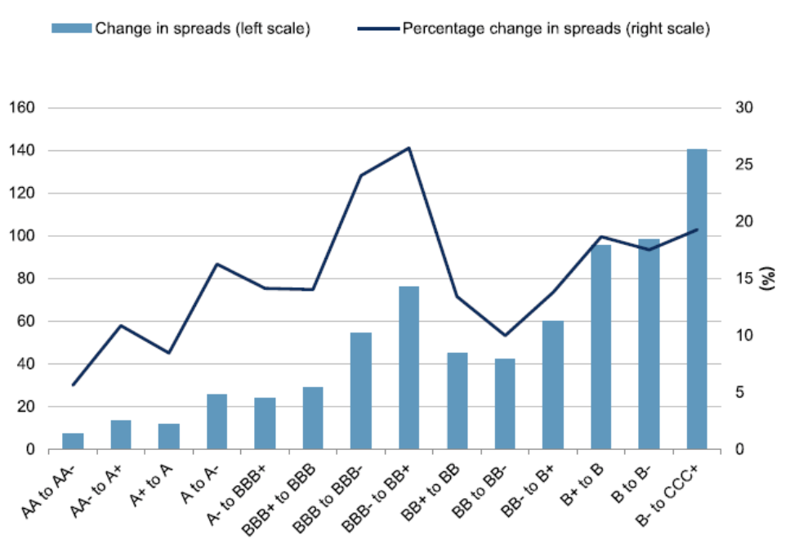
Markov Chain To Predict Credit Rating
Markov chain analysis is one of the most popular methods to estimate future credit ratings. There is a plethora of historical credit rating data available.
Risk managers, portfolio managers and momentum investors use variations of the markov model extensively.

Slide 11
Steps Followed For Analysis
We will follow the below listed steps in order to predict future credit ratings using the markov model:
Obtain historical credit rating data of corporate firms. (We have used FY 2011-2016 S&P data)
Construct the transition count matrix from historical credit rating data.
Construct the transition probability matrix using the transition matrix.
Use the transition matrix and the initial distribution for predictive analysis.

Slide 12
Dataset Description
This dataset represents S&P credit ratings of 901 publicly-traded firms.
28 financial features were considered and the metadata was obtained from bloomberg.
22 states from AAA to D have been considered.
Source : Data

Slide 13
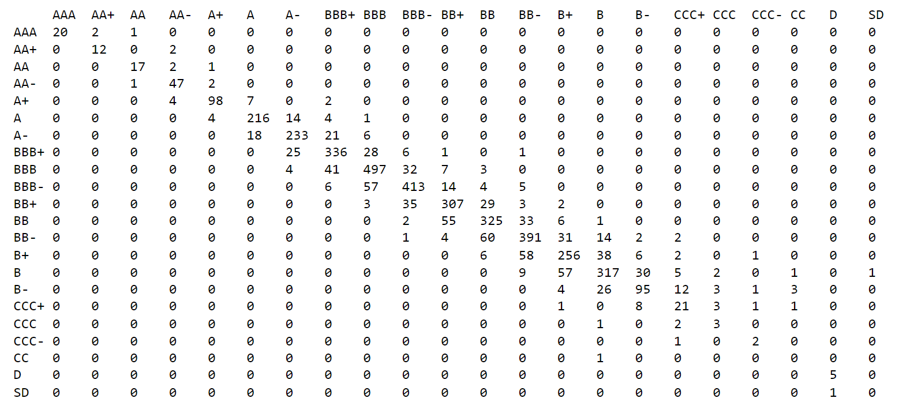
Constructing The Count Transition Matrix
We find the sum of each of the 22 x 22 transitions and construct a 22 x 22 transition matrix for the same. The diagonal elements have the highest entry in each row.

Slide 14
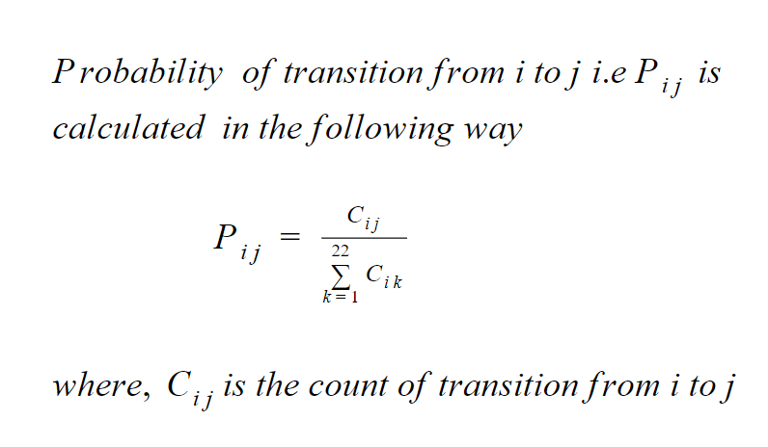
Formula used for getting transition probability matrix
Constructing The Transition Probability Matrix From The Count Transition Matrix

Slide 15
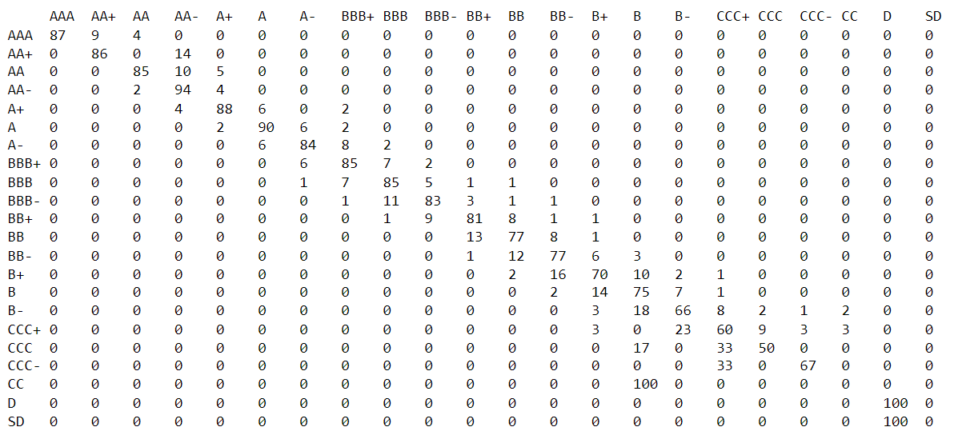
Constructing The Percentage Transition Probability Matrix
To make the final transition probability matrix to be used, we take the sum of each row and divide each of its entries by the rowsum.

Slide 16
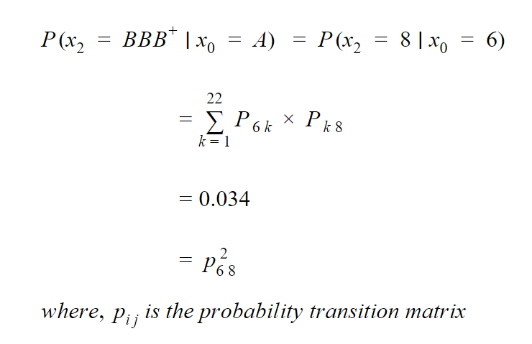
2-period transition
Using Chapman-Kolmogorov Equation

Slide 17
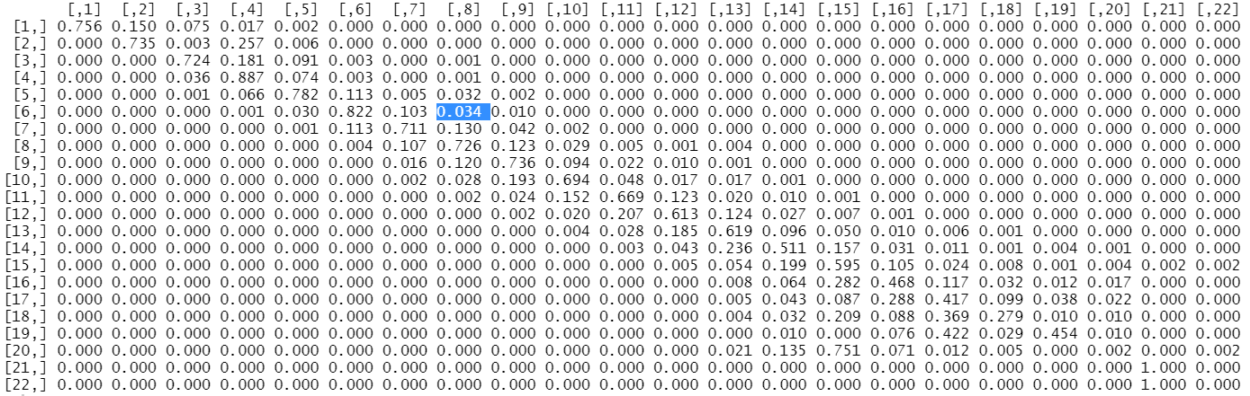
2-period transition
From P²

Slide 18
Probability Distribution of n^{th} state
Π^{n}=Π⁽⁰⁾*P^{n} where Π⁽⁰⁾= initial distribution
P= transition probability matrix

Slide 19
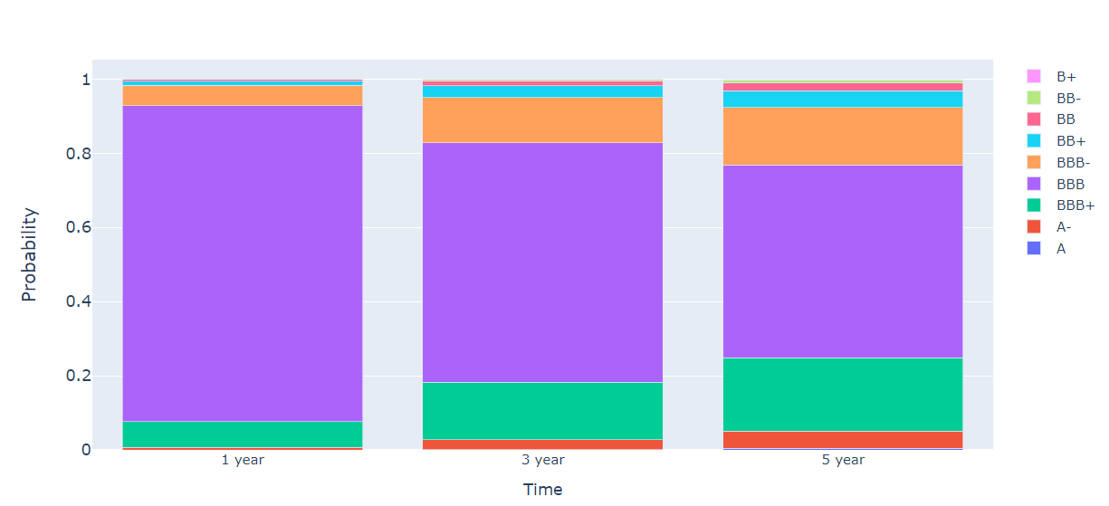
Starting State is BBB:- Probability of states after 1, 3 and 5 years

Slide 20
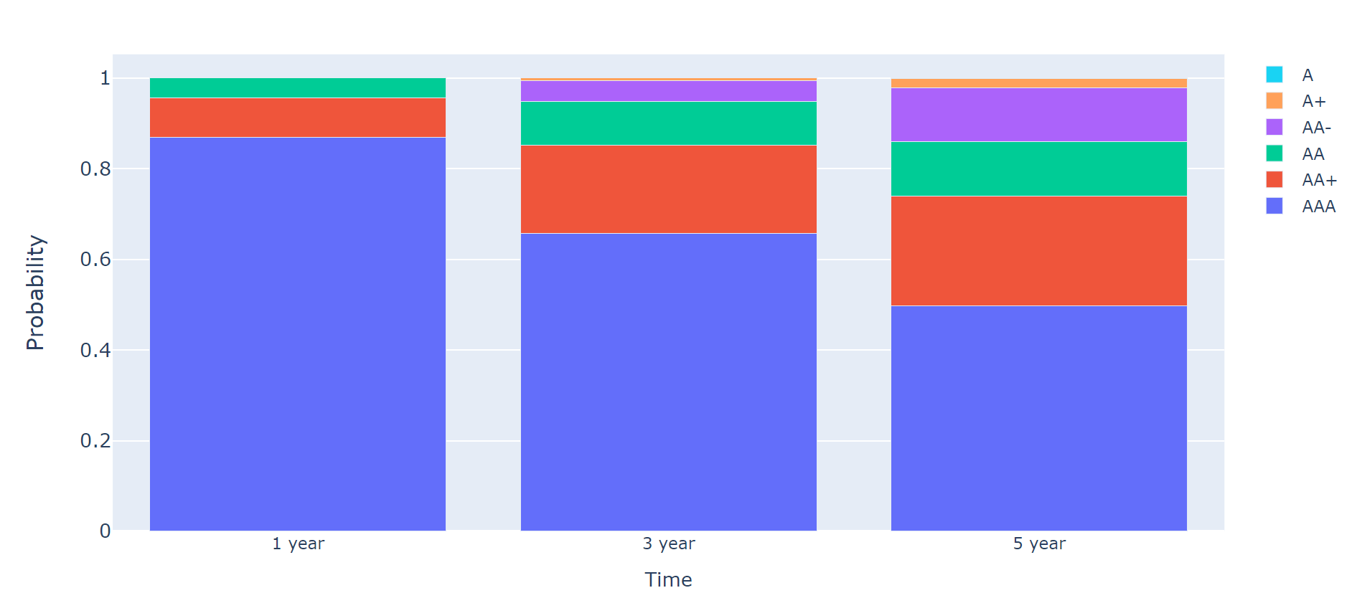
Starting State is AAA:- Probability of states after 1, 3 and 5 years

Slide 21
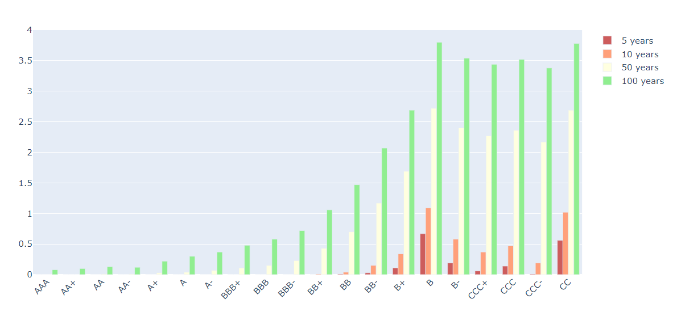
Common Applications In The Finance Industry
Transition probability matrix default column visualization after 5,10,50 and 100 years.
Credit ratings agencies utilise these to judge speculative instruments.

Slide 22
Common Applications In The Finance Industry
2. Using credit rating migration to solve for equity
A firm can use a credit rating transition matrix to solve for the amount of equity capital that it needs. Alternatively a firm can predict the amount of equity in needs to inject in order to stay at a particular level of credit rating. This can be done using the merton model.

Slide 23
Demerits of Credit Rating
Possibility of Bias Effect
Improper disclosure may happen
Impact of changing environment
Problems for new company
Downgrading by rating agency
Difference in rating

Slide 24




Tools Used for the Analysis
Python
Pandas
Numpy
Plotly
R language

Slide 25
References
Ku, Hyejin; Wang, Mingfu (2020), “Data for: Utilizing Historical Data for Corporate Credit Rating Assessment”, Mendeley Data, V1, doi: 10.17632/9fp8w335xf.1 https://data.mendeley.com/datasets/9fp8w335xf/1
https://www.maalot.co.il/Publications/TS20210408160139.PDF
Hadad, M.D.; Santoso, W, (2006) Rating migration matrices: empirical evidence in Indonesia
https://www.bis.org/ifc/publ/ifcb31u.pdf
Using credit rating migration and Merton to solve for Equity
https://youtu.be/7T3_Cg956_E
http://www.columbia.edu/~ww2040/4106S11/MC_BondRating.pdf

Slide 26
Thank You
Members:
Devansh Joshi (2019302)
Mohit Bhar (2019256)
Nikhil Prasad (2019261)
Saksham Mehla (2019270)
Tushar Mahajan (2019280)

